Slide 1
Social Hour
Let's make the most out of your free time

Slide 2
Team Members
Michael Rinehart
Project Manager, Server Administrator
Rocco Ordille
Server Administrator, Data Scientist
Dylan Zeller
Software Engineer, Mobile Developer
Gavin Sentak
User Experience Designer, Mobile Developer
Notes:
~ALL OF US

Slide 3
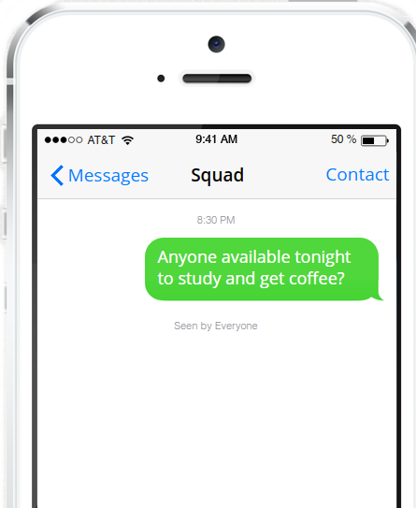
Problem Statement
Coordinating casual, impromptu hangouts are difficult
Communication and coordination is inefficient and time-consuming
Many people are frustrated with the in-depth usage requirement of modern social networks
Public needs a social platform that serves to augment social life, not replace it
Facebook, Twitter and Instagram revolve around feeds generating more content than needed
Once the user is finished using the tool, user experiences the benefits of the platform outside the app
Notes:
~Dylan

Slide 4
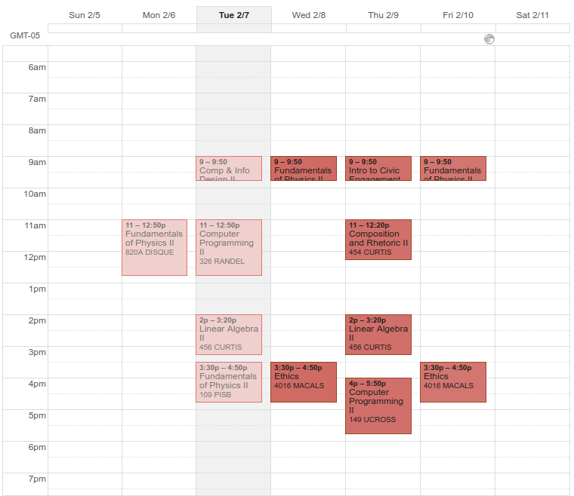
Project Scope - Cycle 1
Platform-agnostic Calendar Interface
A calendar will be developed utilizing Google Calendar API to allow easy integration with other services
Calendar will allow users to plan their schedules and automatically update with upcoming events and availabilities of friends
Mobile Application
An Android application will be developed using Android Studio and React Native to allow users to access the app and manipulate their accounts
Friend Lists/Groups
Users will be able to add friends and join groups so users can be notified of upcoming events or invites from friends/groups
Notes:
~Gavin

Slide 5
Project Scope - Cycle 1
Social Networking
users can tag their events with specific keywords and based on previous events attended Social Hour can recommend events with the use of tags
Intense data analytics will be employed to suggest possible friend groups based on types of events attended, mutual friends, and group membership
Database/Server
A MongoDB installation (hosted on the Drexel Server) will be implemented to store user data
We plan on using RoboMongo to interface with the data storage
Notes:
~Rocco

Slide 6
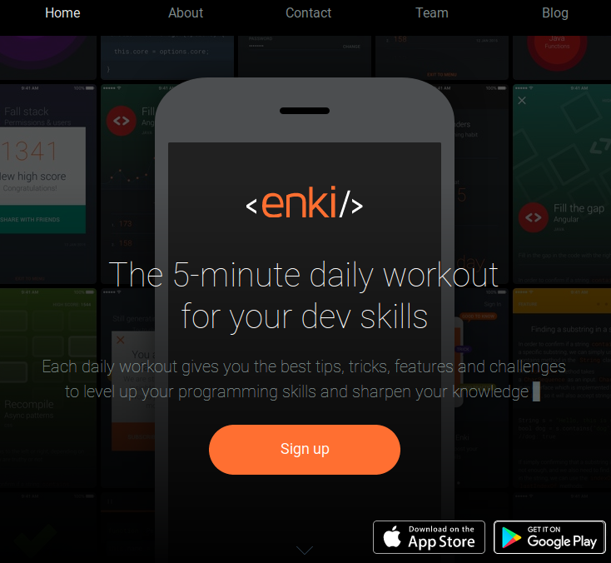
Project Scope - Cycle 1 Stretch Goal
Advertising Placeholder Website
Links to Google Play and later App Store
Pages:
Short bios for each team member
Blog regarding status updates regarding the project
Sign up for an email list regarding status updates
Link to potential KickStarter or GoFundMe
Notes:
~Michael

Slide 7
Project Scope - Beyond Cycle 1
iOS application
Placed into future plans due to monetary and license costs
We plan on using further funding to target iOS as a platform, with iPad, iPhone and Apple Watch support
Fully functional desktop client
Placed into future plans due to time constraints
We aim to develop both a website front-end and a web-based client for desktop users to provide seamless integration of accounts between all three major platforms
Notes:
~Rocco

Slide 8
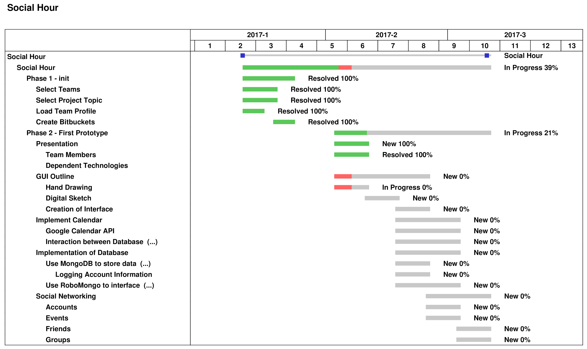
Notes:
~Dylan

Slide 9

Resources Required
Minimum, to get Social Hour started:
Google Play Developer registration (one-time fee of 25$)
Domain registration for Social Hour's website (10-40$)
Server hosting of MongoDB for database management
Eventually:
Apple Macbook with XCode installed to target iOS (already achieved)
App Store Developer registration (100$ per year) to target iOS
Server hosting of full website with identical functionality to mobile app
Notes:
~Rocco

Slide 10

Key Concepts
Events
Individual Scheduled blocks of time
Permission System
Each event has a permission level
At the user's preference different people can see different details regarding the event
Friends
People that have elevated privacy privileges
Your friends list is anonymous, unless you're mutual friends with an individual
Groups
Users can join groups that revolve around classes, entire universities, clubs, friend groups (known as "squads" in the application) and fraternities / sororities
Notes:
~Michael

Slide 11
Target Users
Initial Target Users: University Students
Possibility of users to join multiple hierarchies of groups (universities, courses, sections, etc.) allows for universities as a whole to develop a social network that can augment classroom procedures, including allowing students to share notes and coordinate study sessions and lab completion times
However, as Social Hour grows we plan on targeting users belonging to any organization
End Goal: Implementation of Social Hour on a larger scale
Entire organizations will be able to implement the platform, establishing an official hierarchy of groups for users to join, and automatically schedule mandatory events (such as class times, company meetings, etc.)
Notes:
~Gavin

Slide 12

Project Activities
Develop a database to manage all of the user data
MongoDB & RoboMongo - Document-oriented database software
Both technologies published under the GNU AGPL and the Apache License
Develop an Android application as a front-end for the service
Google Calendar - dependence, then augmentation
Android Studio, with Android Development Kit
Test UX with users
Distribute application prototype throughout students and intended client base
Incorporate feedback into UX design and application optimization
Notes:
~Michael

Slide 13
Image Sources:
http://blog.westmonroepartners.com/10-ways-to-improve-your-next-cx-survey/
http://www.tv.com/shows/friends/
https://pixabay.com/p-970340/?no_redirect
https://www.enki.com/
https://calendar.google.com/calendar
http://www.ios7text.com/

